Slide 1
New jersey high school & Housing market analysis
Rafael Nunez
Priyadarshini Venkataraman
Sam Won

Slide 2



OBJECTIVE
Is it a Misconception?:
Better Ranked Schools ←→ More Expensive Real Estate Market
Lower Ranked Schools ←→ Cheaper Real Estate Market
“We started looking into the affordability of
homes in the state of New Jersey along with
the High Schools spread out in 21 counties.”

Slide 3




OBJECTIVE CONTINUED
What to look for?
Factors and Variables:
School Rank
School Size
Student Demographics
Average Standard Score
Full-Time Teachers
Student / Teacher Ratio
----------------------------------------------------------
Real Estate Prices

Slide 4










DATA SOURCES USED
School Digger
Zillow

Slide 5



DATA EXPLORATION
Method of Sourcing Data Sets:
School Data with Ranking and Other Relevant Data
Real Estate Prices
Widely Used Websites
Free APIs
Private Companies

Slide 6



DATA EXPLORATION & CLEANING
Method of Cleaning Data Sets:
Challenges with Formatting
Empty Rows
Irrelevant Data Sets
Merging Data
Renaming Columns

Slide 7

DATA ANALYSIS - SCHOOLS
2012-2013
New Jersey Public High Schools
Schools: 396
Students: 411,621
Free Lunch Student:
129,528 | 31.47%
Full-time Teachers: 32,579
Overall Student to
Teacher Ratio: 12.6 to 1
White #: 221,660 | 53.85%
Black #: 67,280 | 16.35%
Hispanic #: 82,846 | 20.13%
Asian #: 35,788 | 8.69%
American Indian #: 545 | 0.13%
Pacific Islander #: 804 | 0.20%
Two or More Races #: 2,698 | 0.66%
Average Standard Score: 54.16
Standard Score Min/Max:
(0.00 , 84.80)
Charter School: 15 | 3.7879%
Magnet School: 0 | 0.0000%
Virtual School: 0 | 0.0000%
Title I School: 249 | 62.8788%

Slide 8
DATA ANALYSIS - SCHOOLS
2013-2014
New Jersey Public High Schools
Schools: 411
Students: 419,840
Free Lunch Student:
144,013 | 34.30%
Full-time Teachers: 34,447
Overall Student to
Teacher Ratio: 12.2 to 1
White #: 218,788 | 52.11%
Black #: 71,172 | 16.95%
Hispanic #: 88,127 | 20.99%
Asian #: 36,651 | 8.73%
American Indian #: 792 | 0.19%
Pacific Islander #: 756 | 0.18%
Two or More Races #: 3,116 | 0.74%
Average Standard Score: 54.37
Standard Score Min/Max:
(0.00 , 83.70)
Charter School: 18 | 4.3796%
Magnet School: 0 | 0.0000%
Virtual School: 0 | 0.0000%
Title I School: 260 | 63.2603%

Slide 9
DATA ANALYSIS - SCHOOLS
2014-2015
New Jersey Public High Schools
Schools: 406
Students: 417,967
Free Lunch Student:
138,607 | 33.16%
Full-time Teachers: 34,414
Overall Student to
Teacher Ratio: 12.1 to 1
White #: 213,364 | 51.05%
Black #: 71,691 | 17.15%
Hispanic #: 90,469 | 21.65%
Asian #: 37,478 | 8.97%
American Indian #: 542 | 0.13%
Pacific Islander #: 797 | 0.19%
Two or More Races #: 3,626 | 0.87%
Average Standard Score: 44.00
Standard Score Min/Max:
(9.00 , 99.30)
Charter School: 21 | 5.1724%
Magnet School: 0 | 0.0000%
Virtual School: 0 | 0.0000%
Title I School: 258 | 63.5468%

Slide 10
DATA ANALYSIS - SCHOOLS
2015-2016
New Jersey Public High Schools
Schools: 409
Students: 422,707
Free Lunch Student:
144,462 | 34.18%
Full-time Teachers: 34,437
Overall Student to
Teacher Ratio: 12.3 to 1
White #: 209,865 | 49.65%
Black #: 72,726 | 17.20%
Hispanic #: 96,200 | 22.76%
Asian #: 38,506 | 9.11%
American Indian #: 497 | 0.12%
Pacific Islander #: 802 | 0.19%
Two or More Races #: 4,111 | 0.97%
Average Standard Score: 44.78
Standard Score Min/Max:
(4.90 , 99.20)
Charter School: 21 | 5.1345%
Magnet School: 0 | 0.0000%
Virtual School: 0 | 0.0000%
Title I School: 263 | 64.3032%

Slide 11
DATA ANALYSIS - SCHOOLS
2016-2017
New Jersey Public High Schools
Schools: 411
Students: 422,320
Free Lunch Student:
144,157 | 34.13%
Full-time Teachers: 34,494
Overall Student to
Teacher Ratio: 12.2 to 1
White #: 209,827 | 49.68%
Black #: 72,718 | 17.22%
Hispanic #: 95,862 | 22.70%
Asian #: 38,501 | 9.12%
American Indian #: 499 | 0.12%
Pacific Islander #: 801 | 0.19%
Two or More Races #: 4,112 | 0.97%
Average Standard Score: 44.87
Standard Score Min/Max:
(5.60 , 98.80)
Charter School: 20 | 4.8662%
Magnet School: 0 | 0.0000%
Virtual School: 0 | 0.0000%
Title I School: 264 | 64.2336%

Slide 12
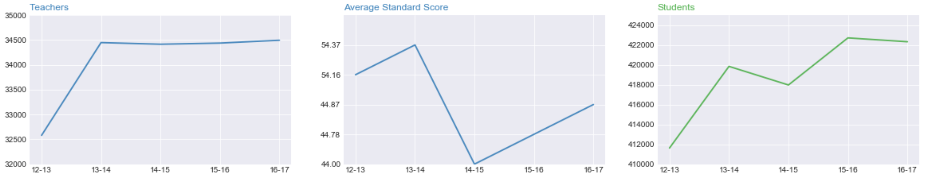
DATA ANALYSIS - SCHOOLS

Slide 13
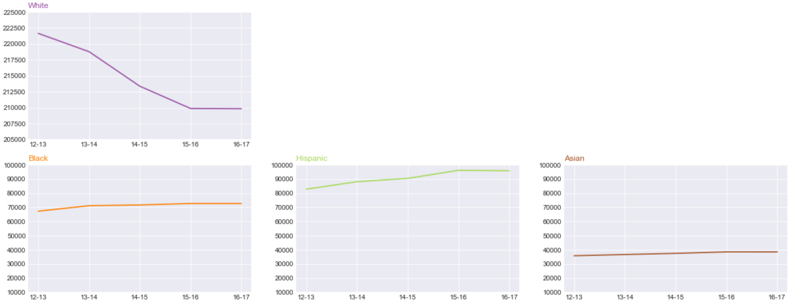
DATA ANALYSIS - SCHOOLS

Slide 14
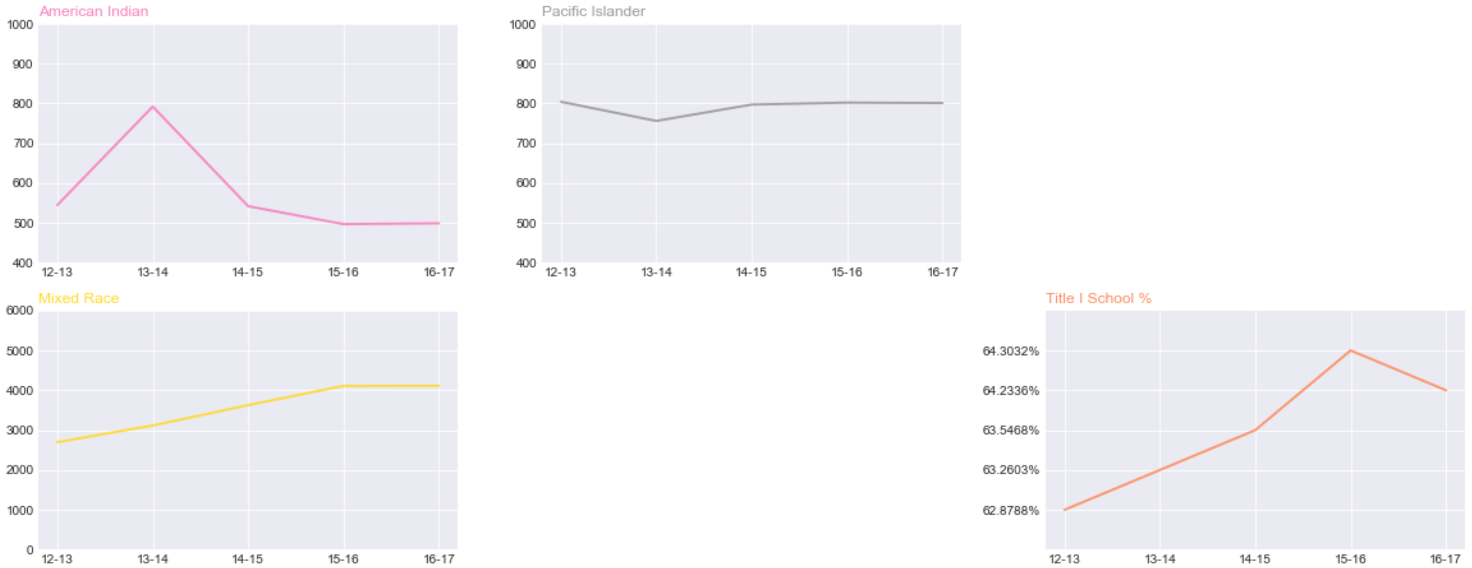
DATA ANALYSIS - SCHOOLS

Slide 15

DATA ANALYSIS - SCHOOLS
Insights from the Overall School Data:
Average Standard Score
Title I Schools
Students
Student / Teacher Ratio
Teachers
Race Distribution and Correlation
School Ranking

Slide 16
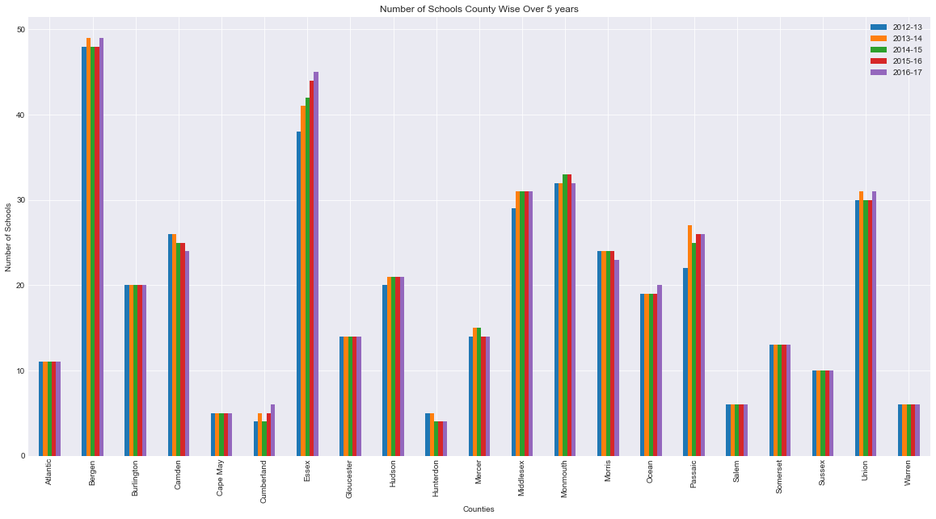
DATA ANALYSIS – SCHOOLS / COUNTY

Slide 17
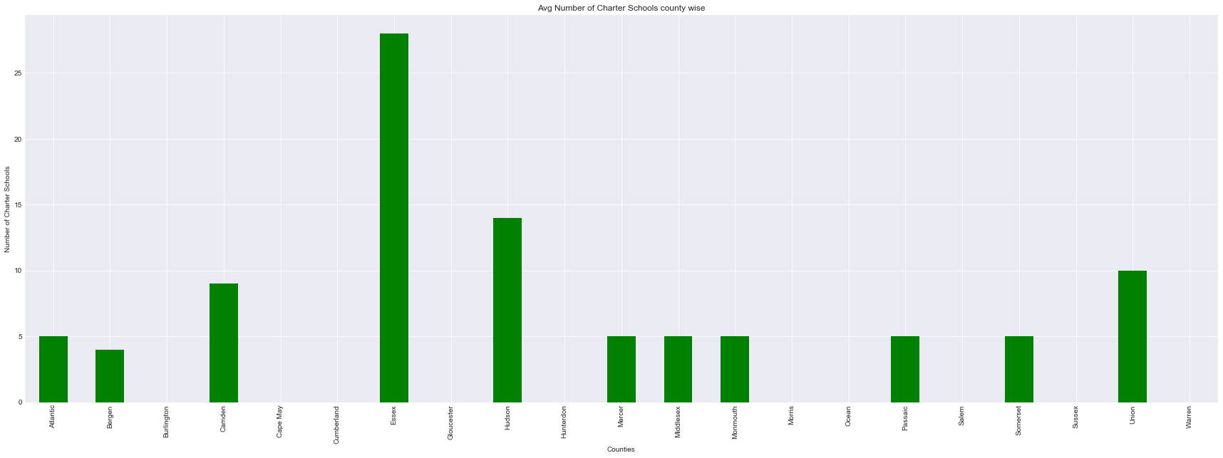
DATA ANALYSIS – SCHOOLS / COUNTY

Slide 18
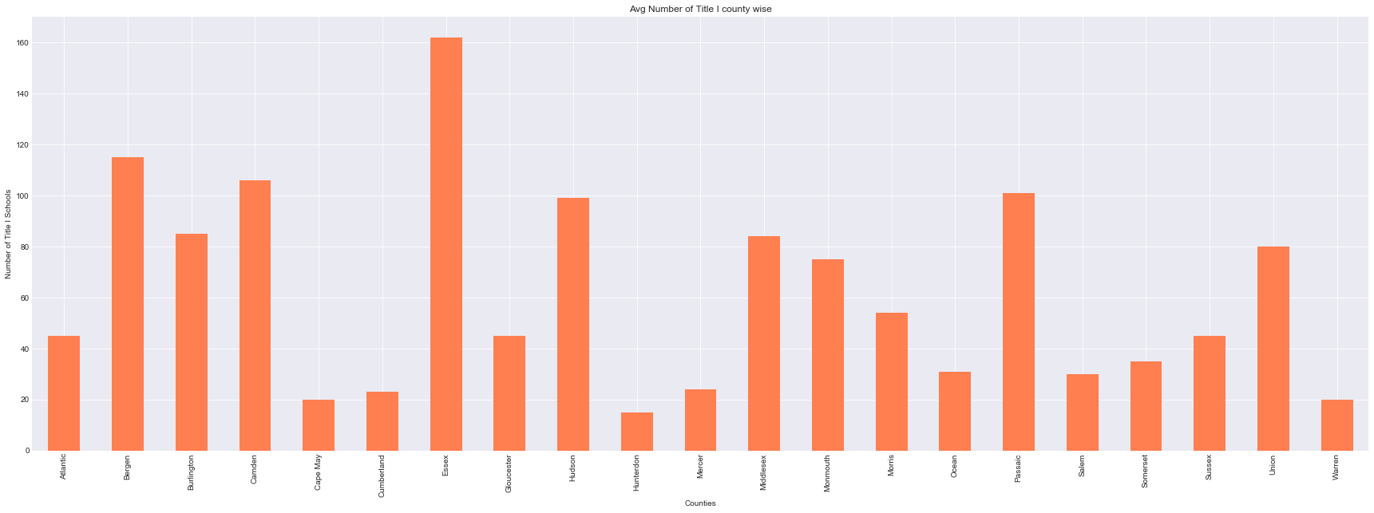
DATA ANALYSIS – SCHOOLS / COUNTY

Slide 19

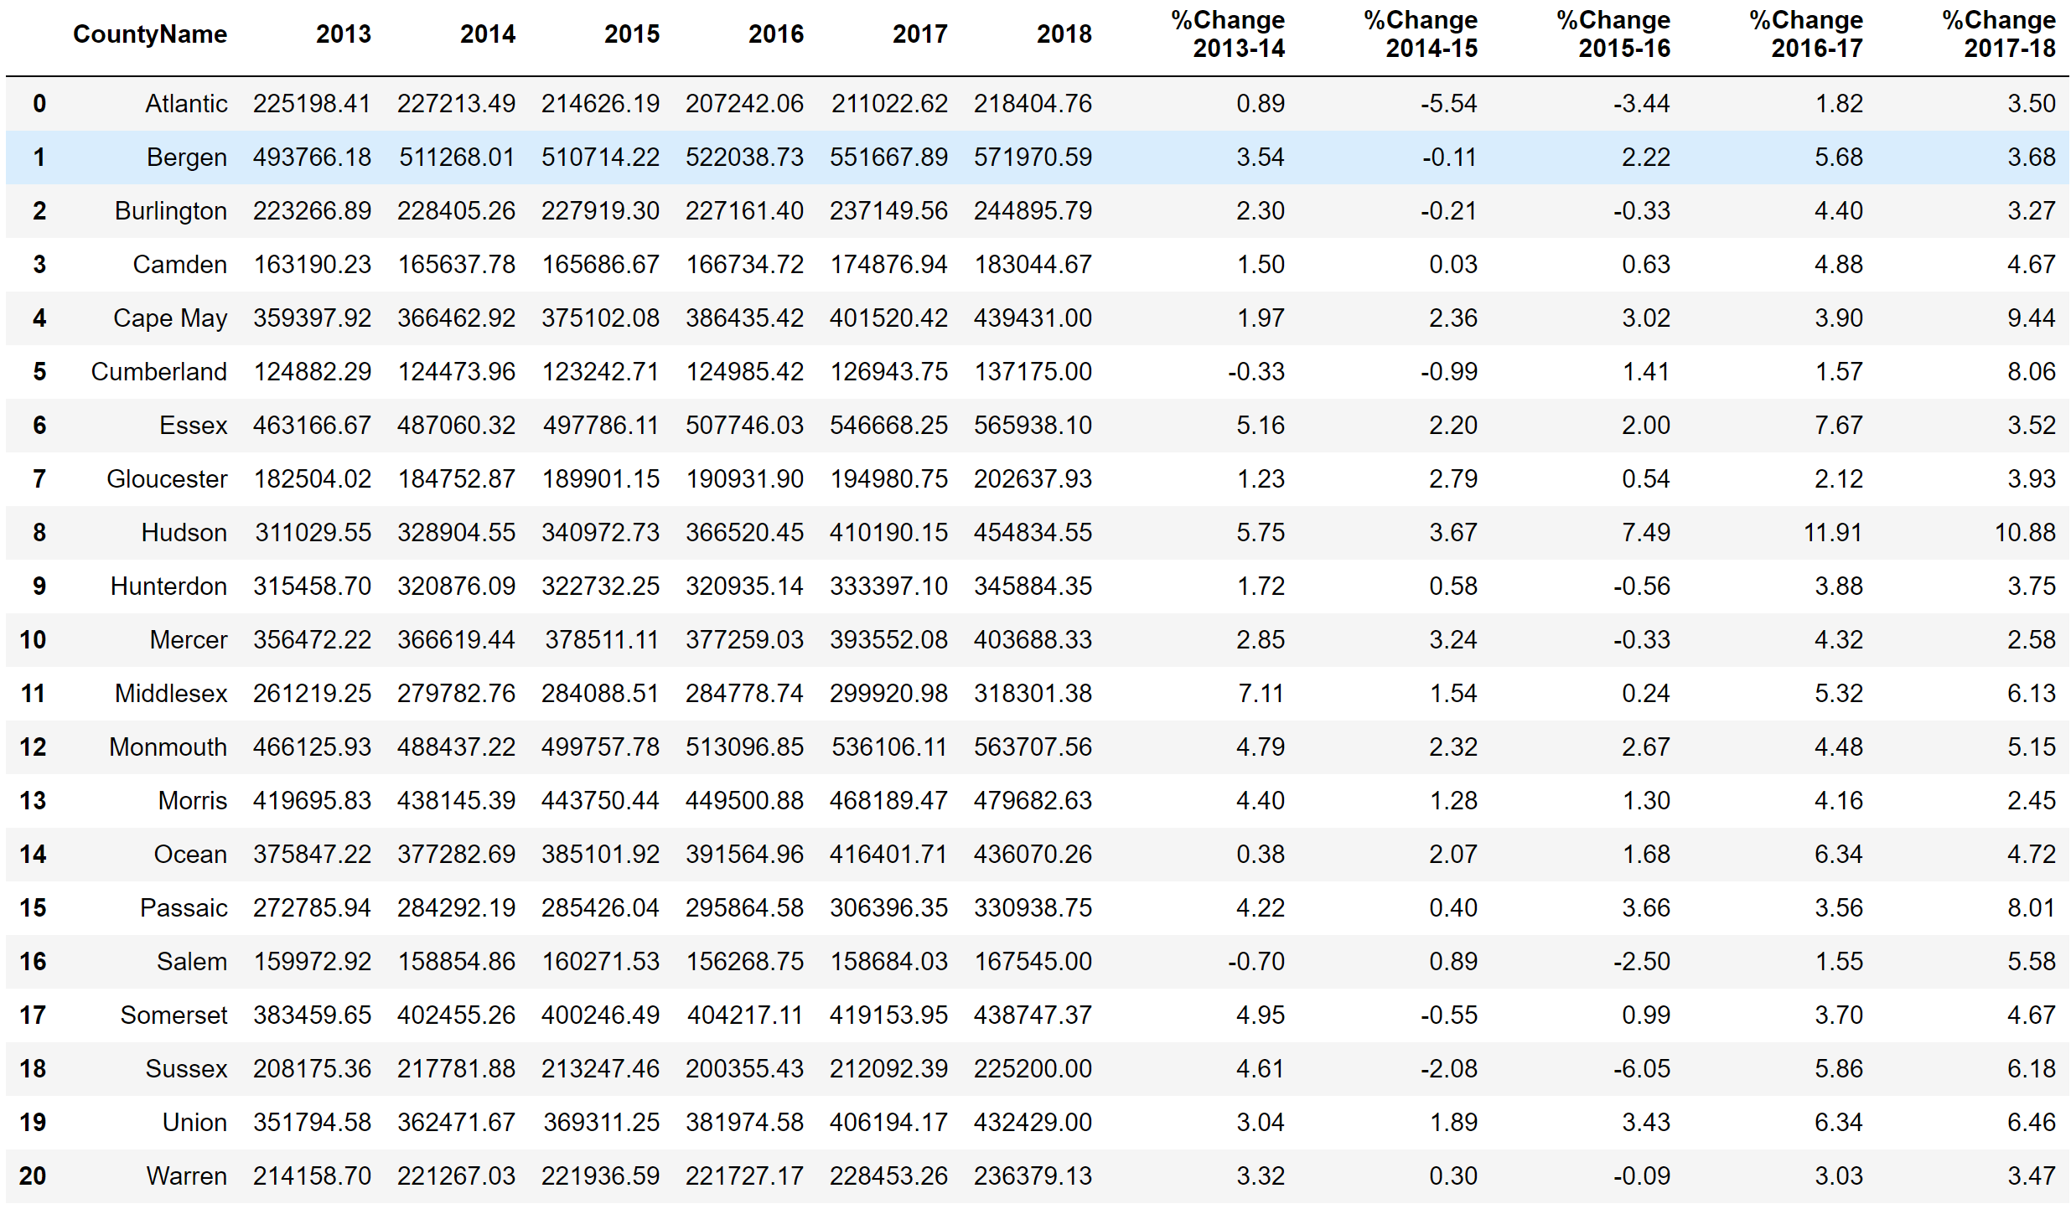
DATA ANALYSIS – HOUSING PRICES

Slide 20
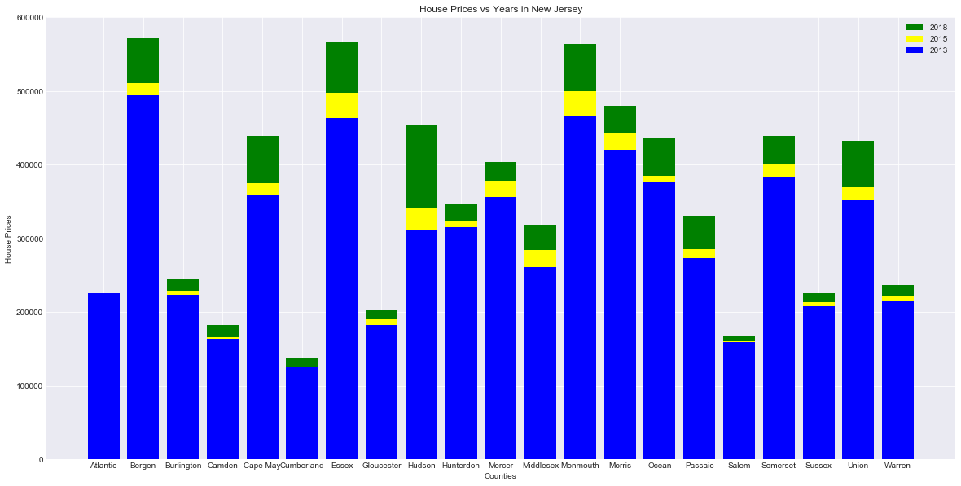
DATA ANALYSIS – HOUSING PRICES

Slide 21
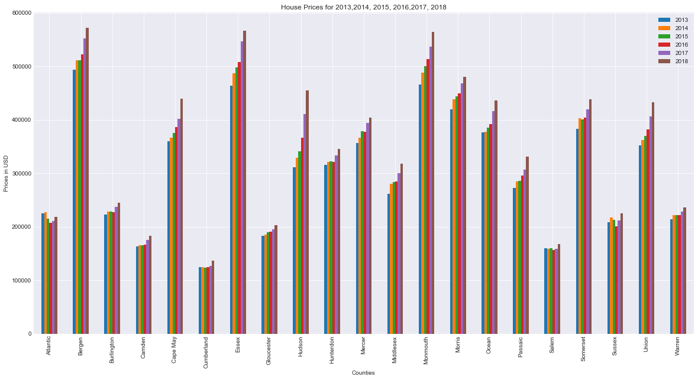
DATA ANALYSIS – HOUSING PRICES

Slide 22
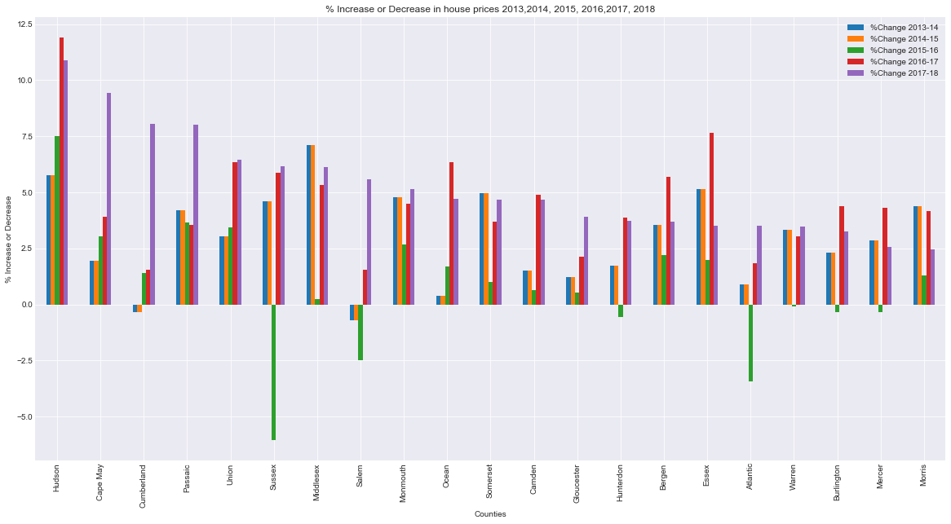
DATA ANALYSIS – HOUSING PRICES

Slide 23


DATA ANALYSIS - CONCLUSION
Little to No Trend/Correlation
Graphical & Numerical Evidences
All Factors Considered? No
Possible Lead

Slide 24



DATA ANALYSIS – AFTER THOUGHT
Difficulties
Subsequent Questions
Potential Change in Direction
Additional Research Topics
What Could Change?

Slide 25


Q & A

